Slide 1


Department of Computer Science and Engineering
BRAIN TUMOR DETECTION USING VISION TRANSFORMER
Mrs.J.A.Adlin layola
Assistant Professor
B21A2425C21
Mitesh.A(210701158)
Pavithiren.D.S(210701187)

Slide 2
Problem Statement and Motivation
Brain tumor detection is challenging due to the limitations of manual MRI analysis and traditional deep learning models like CNNs, which struggle with complex patterns. This project leverages Vision Transformers (ViTs) to extract both local and global features, creating an automated system that enhances diagnostic accuracy, reduces workload, and improves patient outcomes. It bridges research and clinical applications, advancing AI-driven healthcare.

Slide 3
Objectives
Improve diagnostic speed and accuracy with AI-driven methods.
Reduce radiologists’ workload by automating tumor detection from MRI scans.
Evaluate model reliability using metrics like accuracy, precision, recall, and F1-score.
Enhance healthcare outcomes by integrating a scalable and robust AI solution.

Slide 4
Abstract
Brain tumor detection is a critical medical task requiring precise and early diagnosis to improve treatment outcomes. Manual analysis of MRI scans is time-intensive, prone to errors, and depends on the expertise of radiologists. This project employs Vision Transformers (ViTs), leveraging their self-attention mechanism to capture both global and local features in MRI scans, addressing the limitations of traditional methods like Convolutional Neural Networks (CNNs). The model is trained on curated datasets, utilizing advanced preprocessing, data augmentation, and performance evaluation metrics such as accuracy, precision, recall, and F1-score.

Slide 5
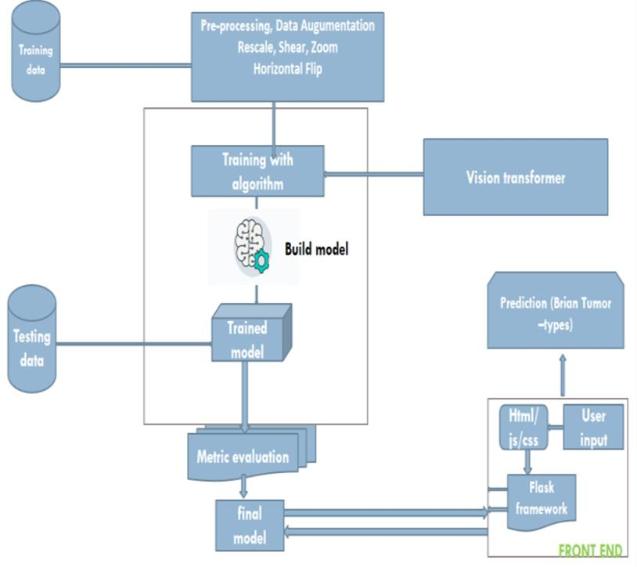
System Architecture

Slide 6
List of Modules
1. Data Acquisition Module: Fetches MRI brain images from datasets like Kaggle and BRaTS, ensuring diversity in tumor types and healthy samples.
2. Preprocessing Module: Standardizes images through resizing, normalization, and augmentation to prepare data for the Vision Transformer model.
3. Model Development Module: Implements the Vision Transformer architecture, enabling efficient feature extraction and classification.
4. Training and Optimization Module: Trains the model using techniques like cross-entropy loss, Adam optimizer, and regularization to prevent overfitting.
5. Evaluation Module: Evaluates the model using metrics like accuracy, precision, recall, F1-score, and confusion matrices to validate its reliability.
6. Deployment Module: Integrates the trained model into a Flask-based application for real-time predictions and user interaction.

Slide 7
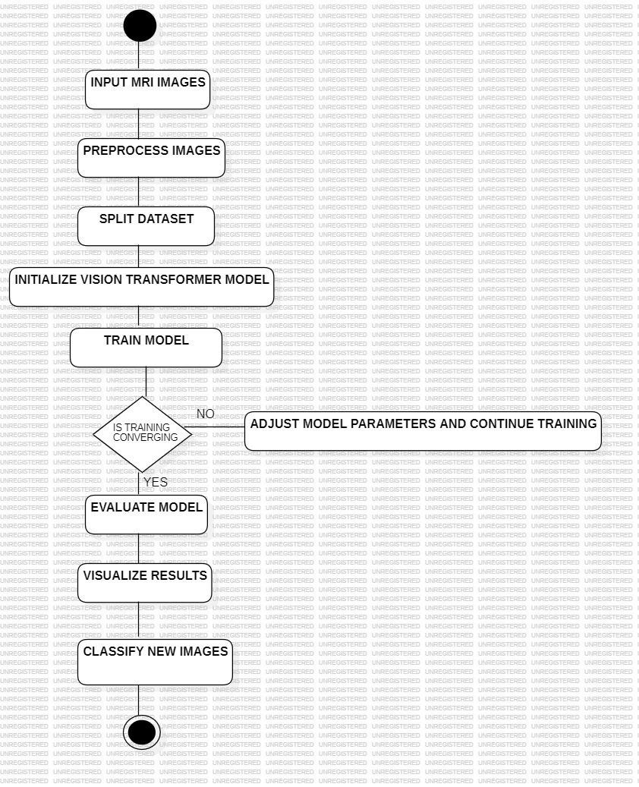
Functional Description for each modules with DFD and Activity Diagram

Slide 8
Functional Description for each modules with DFD and Activity Diagram
It outlines a pipeline for MRI image classification using a Vision Transformer (ViT) model. The process begins with inputting and preprocessing MRI images, followed by dataset splitting. A Vision Transformer model is initialized and trained, with adjustments to model parameters if training convergence issues arise. Once the training converges, the model is evaluated, results are visualized, and the trained model is used to classify new images. This iterative process ensures optimal performance in medical image analysis

Slide 9
Implementation & Results of First Module
we used Vision Transformers (ViTs) to analyze MRI images and construct a brain tumor detection model. Both tumorous and non-tumorous brain images were included in the extensive dataset used to train and verify the model. In contrast to conventional Convolutional Neural Networks (CNNs), Vision Transformers use a self-attention mechanism to extract global context from the full image. This characteristic makes it possible for the model to identify minute irregularities and complex patterns in MRI scans, which are frequently suggestive of malignancies.The implementation of the model, Vision Transformer (ViT), for brain tumor detection resulted in the following key findings

Slide 10
Conclusion & Work for Phase II
In phase two of the project, a series of enhancements will be implemented to further optimize the types of the tumour by adding more augmented and sample datasets of the existing data . This phase focuses on four key areas: advanced data augmentation, model optimization, data storage, and automated reporting, each aimed at improving the system's overall performance and functionality.
To start, advanced data augmentation techniques will be employed to improve the model's ability to generalize across various scenarios.With a test accuracy of 98.76%, the model demonstrates exceptional reliability and suitability for clinical application.

Slide 11
References
B. Menze et al., ―The multimodal brain tumor image segmentation benchmark (BRATS),‖ IEEE Trans. Med. Imag., vol. 34, no.10, pp. 1993–2024, Oct. 2015
Vinod Kumar, JainySachdeva, Indra Gupta ―Classification of brain tumors using PCA-ANN‖ 2011 World Congress on Information andCommunication Technologies
S. Bakas, H. Akbari, A. Sotiras, M. Bilello, M. Rozycki, J.S. Kirby, et al., "Advancing The Cancer Genome Atlas glioma MRI collections with expert segmentation labels and radiomic features", Nature Scientific Data, 4:170117 (2017) DOI: 10.1038/sdata.2017.117

Slide 12
Paper Publication Status
Applied and Waiting for acceptance

Slide 13
Thank You

